Slide 1
Central Tendency and Variability
Chapter 4

Slide 2
Central Tendency
Definition: descriptive stat that best represents the center of a distribution of data.
Mean: arithmetic average
“Typical score”
Often described as the “middle” of the scores, so don’t confuse this with medians

Slide 3
Calculating the Mean
Add up all scores
Divide by number of scores
Traditionally, we use M as the symbol for sample means
Notes:
Even though in psych we usually use M as the symbol for sample mean, you may see it written like it is above, as and X with a line above it, so just know that this is also a symbol for sample mean.

Slide 4
Note on Symbols
Usually Latin letters (normal alphabet) are used for samples
M, SD
Sample statistics
Greek letters are used for populations
μ, σ
Population parameters
All statistical letters are italicized

Slide 5
Central Tendency
Median: middle score when ordered from lowest to highest
No real symbol, but you can abbreviate mdn

Slide 6
Calculating the Median
Line up the scores in ascending order
Find the middle number
For an odd number of scores, just find the middle value
For an even number of scores, divide number of scores by two
Take the average of the scores around this position

Slide 7
Central Tendency
Mode: most common score
It’s the value:
With the largest frequency (or percent on a table)
The highest bar on a histogram (depends on binwidth though)
The highest point on a frequency polygon
Note…sometimes there are multiple modes.

Slide 8
Calculating the Mode
Line up the scores in ascending order
Find the most frequent score
That’s the Mode!

Slide 9
Mode + Distributions
We talked about this before but:
Unimodal = distributions with one mode (one hump)
Bimodal = distributions with two modes (two humps)
Multimodal = distributions with three+ mode (3+ humps)
Can be kind of up to interpretation also:
e.g., if there are 10-5s and 10-6s (that is technically two modes) but people would consider that unimodal because they are so close together (there would only be one hump in the histogram)

Slide 10
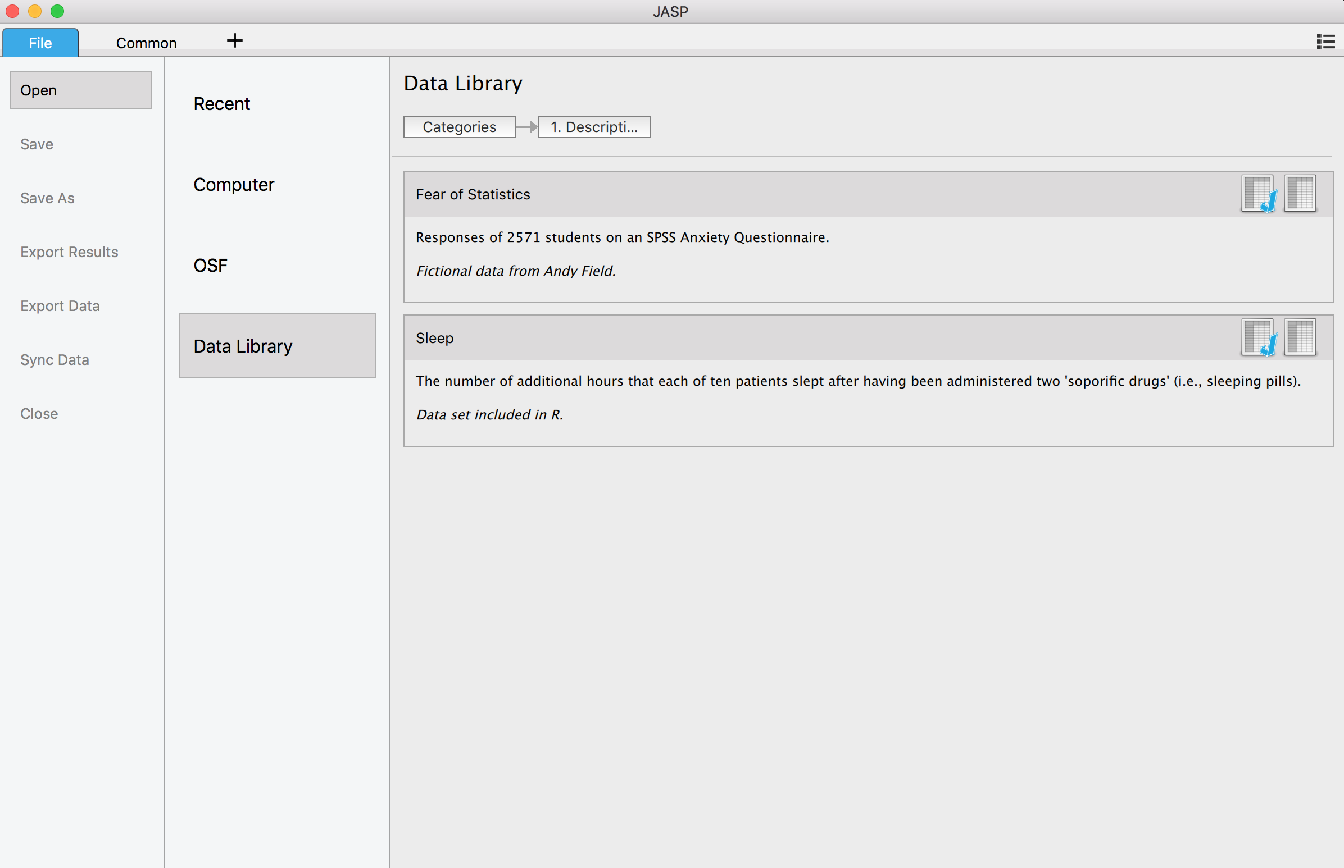
How-To JASP
Open your dataset/enter the data

Slide 11
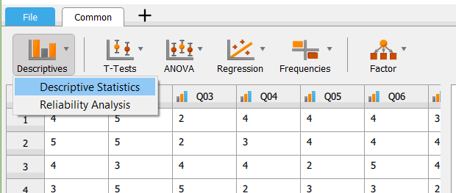
How-To JASP
Central tendency measures are part of descriptive statistics
To get your descriptive statistics, go to “Descriptives” →
“Descriptive Statistics”

Slide 12
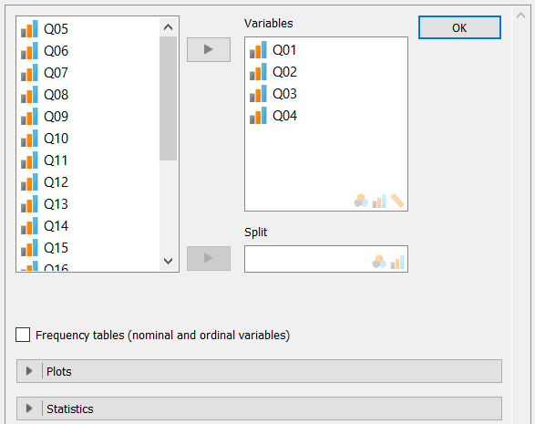
How-To JASP
Move the variables you want to analyze over to the box on the right

Slide 13
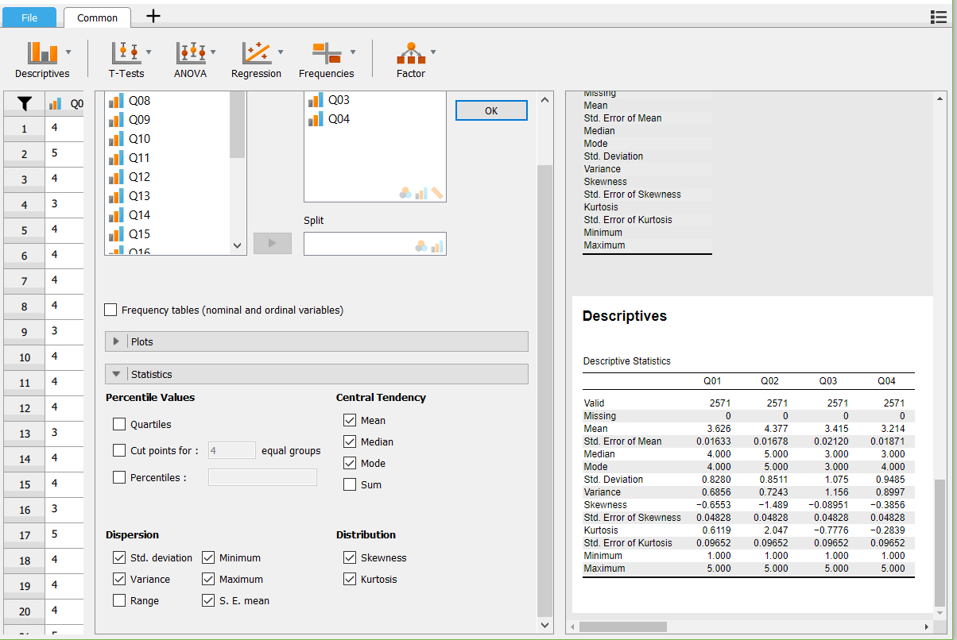
How-To JASP
Select all of the statistics that you want to run

Slide 14
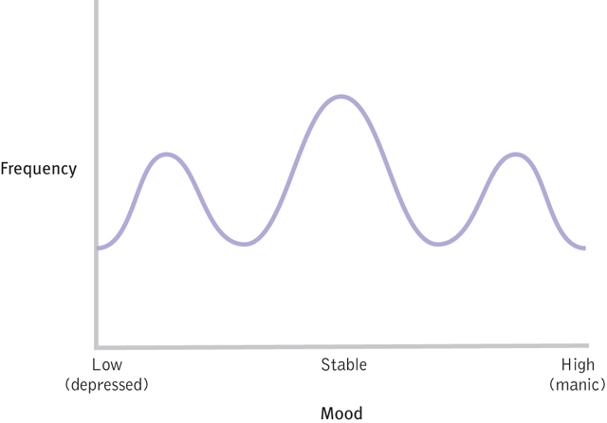
Why central tendency is not always the best answer:
Figure 4-4: Bipolar Disorder and the Modal Mood

Slide 15
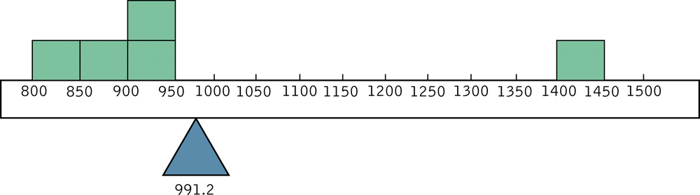
Outliers and the Mean
Outliers: extreme scores in comparison to the other data
An early lesson in lying with statistics
Here is the mean of a dataset with an outlier

Slide 16
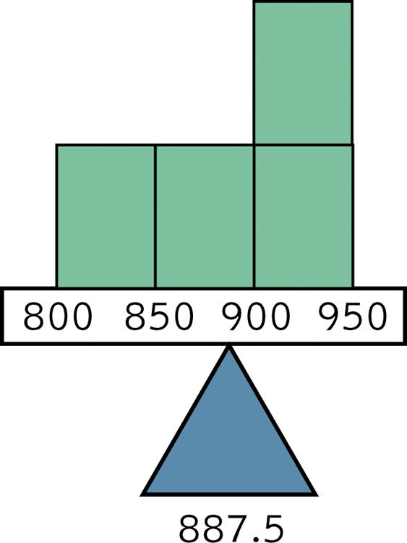
Outliers and the Mean
Here’s the same dataset, but excluding the outlier
That’s a much better representation
Notes:
Outliers can really throw off measures of central tendency… make sure you actually look at the data!

Slide 17
What happens if we delete our outliers?
Changes in central tendency measures:
Mean is most affected by outliers (moved up or down, can be by a lot)
Median may change slightly one number up or down
Generally the mode will not change
So what should be do?
Can always run the descriptives with and without outliers to see if the outliers are changing anything a lot

Slide 18
Which Central Tendency Measure is the “best”?
Really just depends!
Summary:
Mean is best for symmetric distributions since outliers/skewed data can change it a lot
Median is best for skewed distributions or datasets with outliers since these problems don’t change it much
Mode is best for data where:
One particular score dominates a distribution
Distribution is bi- or multi- modal
Data are nominal
Gives you a better idea of where the majority of the data is

Slide 19
Measures of Variability
Variability: a measure of how much spread there is in a distribution
Range: from the lowest to the highest score

Slide 20
Calculating the Range
Determine the highest score
Determine the lowest score
Subtract the lowest score from the highest score

Slide 21
How to JASP
When you are running your descriptives just also check the box beside “Range” to give you the value in your output
Or… you can use your min and max values from your output:
Range = max - min

Slide 22
Measures of Variability
Variance
Mathematically: average squared deviation from the mean
How much, on average, do people vary from the middle?

Slide 23
Calculating the Variance
Subtract the mean from each score
Square every deviation from the mean
Sum the squared deviations
Divide the sum of squares by N
Notes:
Super special notes right here about N versus N-1
Samples usually use N-1 as the denominator
Populations usually use N as the denominator

Slide 24
Measures of Variability
Standard deviation
Mathematically: square root of variance
Typical amount that each score deviates from the mean
Most commonly used statistic with the mean
Why use this when variance says the same thing?
Brings the numbers back to the original scaling (since they were squared for variance)
Still biased by scale

Slide 25
Calculating the Standard Deviation
Typical amount the scores vary or deviate from the sample mean
This is the square root of variance

Slide 26
Quick Notes about Formulas
Samples usually use N – 1 as the denominator
UNBIASED
**this is what JASP does
Populations usually use N as the denominator
BIASED
Notes:
Biased to use N because it would assume we got every single person’s score right; N-1 accounts for us at least getting one wrong

Slide 27
Interquartile Range
Measure of the distance between the 1st and 3rd quartiles
1st quartile: 25th percentile of a data set
The median marks the 50th percentile of a data set
3rd quartile: marks the 75th percentile of a data set

Slide 28
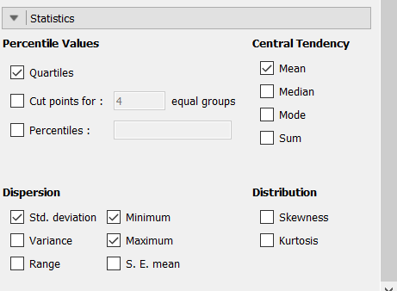
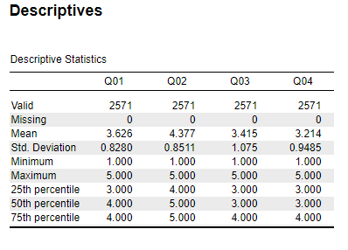
How to JASP
When you are running your descriptives just also check the box beside “Quartiles”
This will give you the 25th (Q1), 50th, and 75th (Q3) percentiles in your output
To calculate the interquartile range (IQR):
IQR = Q3 – Q1

